Slide 1


GALACTIC ROTATION CURVE
DONE BY -
MANASWINI - CB.AI.U4AIM24129
RAGHU HARSHA VARDHAN - CB.AI.U4AIM24135
VEDANG PRATAP SINGH - CB.AI.U4AIM24151
AYYAPPA HARSHA VARDHAN - CB.AI.U4AIM24155
23MAT112 - MATHEMATICS FOR INTELLIGENT SYSTEMS 2
24AIM111 INTRODUCTION TO DATA STRUCTURES & ALGORITHMS
1

Slide 2
UPDATES
Collected dataset suitable for the project
Plotted the rotation curve graphs
Simulated a model of ten star system
2

Slide 3
DATA STRUCTURES AND ALGORITHMS
Brute force - for N-body simulation
Euler's Method- updates positions and velocities at each time step
Hernquist Profile- for dark matter acceleration
Trust Region Reflective algorithm- for non-linear curve fitting
3

Slide 4

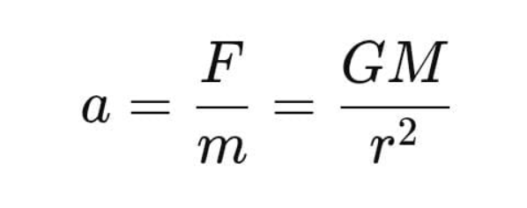
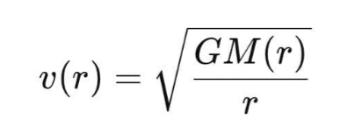
KEY EQUATIONS
Gravitational force and acceleration- based on Newton’s laws
Equations of Circular Velocity for Stable Orbits
where:
G= Gravitational constant
r= radius
M(r)=mass enclosed within radius
4

Slide 5
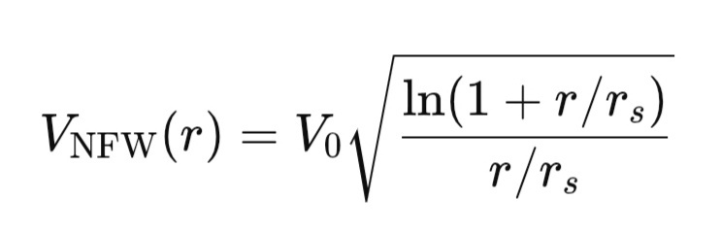
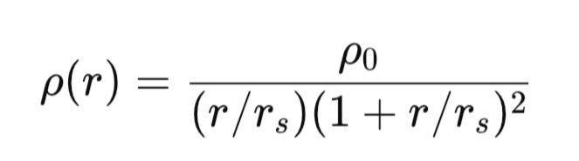
Navarro-Frenk-White (NFW) Profile for Dark Matter Halo Model
Where:
ρ_0= density constant
V_0= scale velocity
r_s=scale radius
5

Slide 6
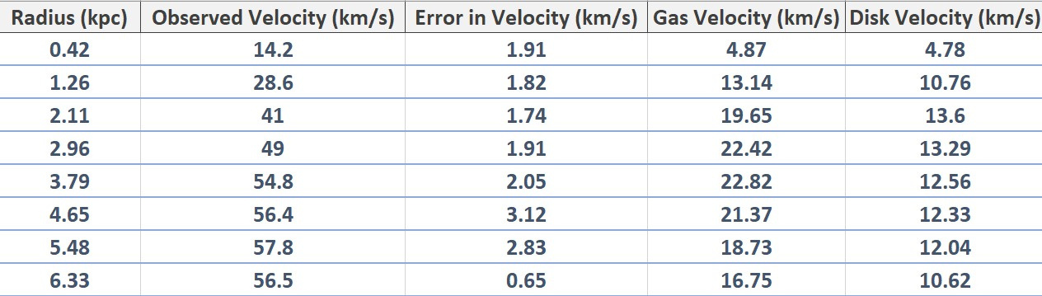
SNAPSHOT OF DATASET
Dataset for UGCA 442
http://astroweb.cwru.edu/SPARC
6

Slide 7
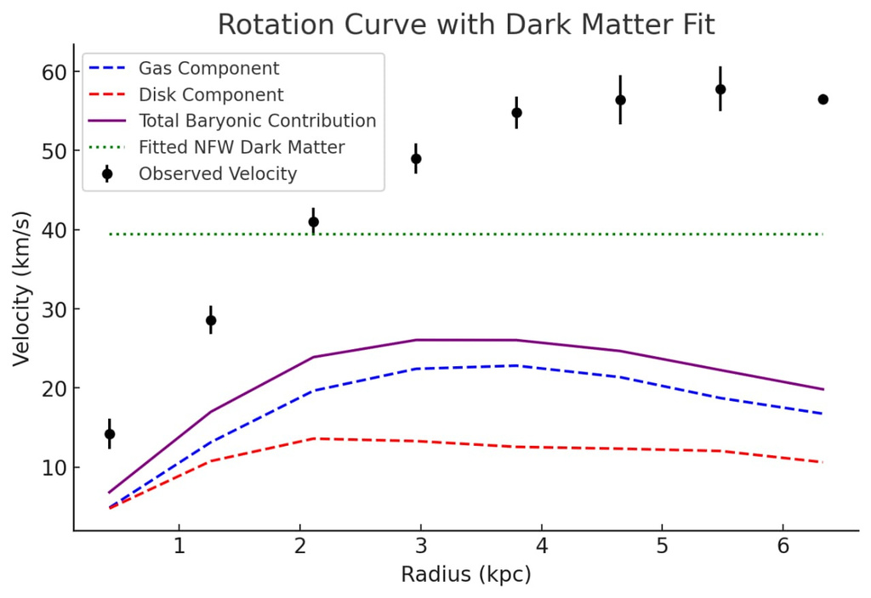
RESULTS
If the galaxy followed Newtonian dynamics without dark matter, the velocities should decrease at larger radii.
The observed velocity remains nearly constant or declines slowly at large radii, implying the presence of dark matter.
7

Slide 8
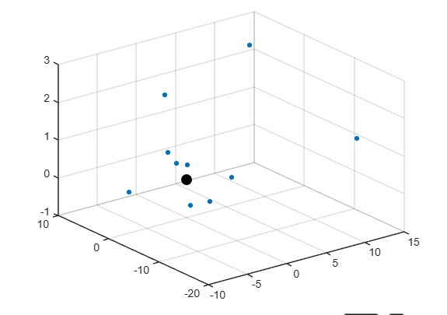
Simple N-body simulation
The simulation models the motion of stars in a simplified spiral galaxy, considering the effects of a supermassive dark matter halo.
8

Slide 9
Thank You
9

Slide 10
10

